Slide 1
Data as a Strategic Asset
Transforming Architecture
Simplifying Decisions
Notes:
Slide 1 – Introduction (1 minute)
With this presentation, I would like to introduce a prototype that demonstrates how Allianz can transform its data architecture to simplify decision-making and unlock strategic value. In addition, I will address the four other challenges outlined in the assessment document.

Slide 2
Agenda
01
02
New Architecture Overview
Diagram
Layers & Functionalities
Artifacts & Modules
E2E Data Engineering Projects
Sales Dashboard
Churn Prediction Model
2/12
Notes:
Slide 2 – Agenda (1 minute) This is today’s agenda, which is divided into two main topics: 1. New Architecture Overview I'll walk through:
The Architecture Diagram
Different Layers and Functionalities
Key Artifacts and Modules involved
2. E2E Data Engineering Projects
I'll present two concrete examples:
The Sales Dashboard, showcasing data visualization and business KPIs
The Churn Prediction Model, highlighting predictive analytics usecase

Slide 3
New Data Architecture Overview
Notes:
Slide 3 – New Architecture Overview (15 seconds) To begin with - the first topic, New Architecture Overview

Slide 4



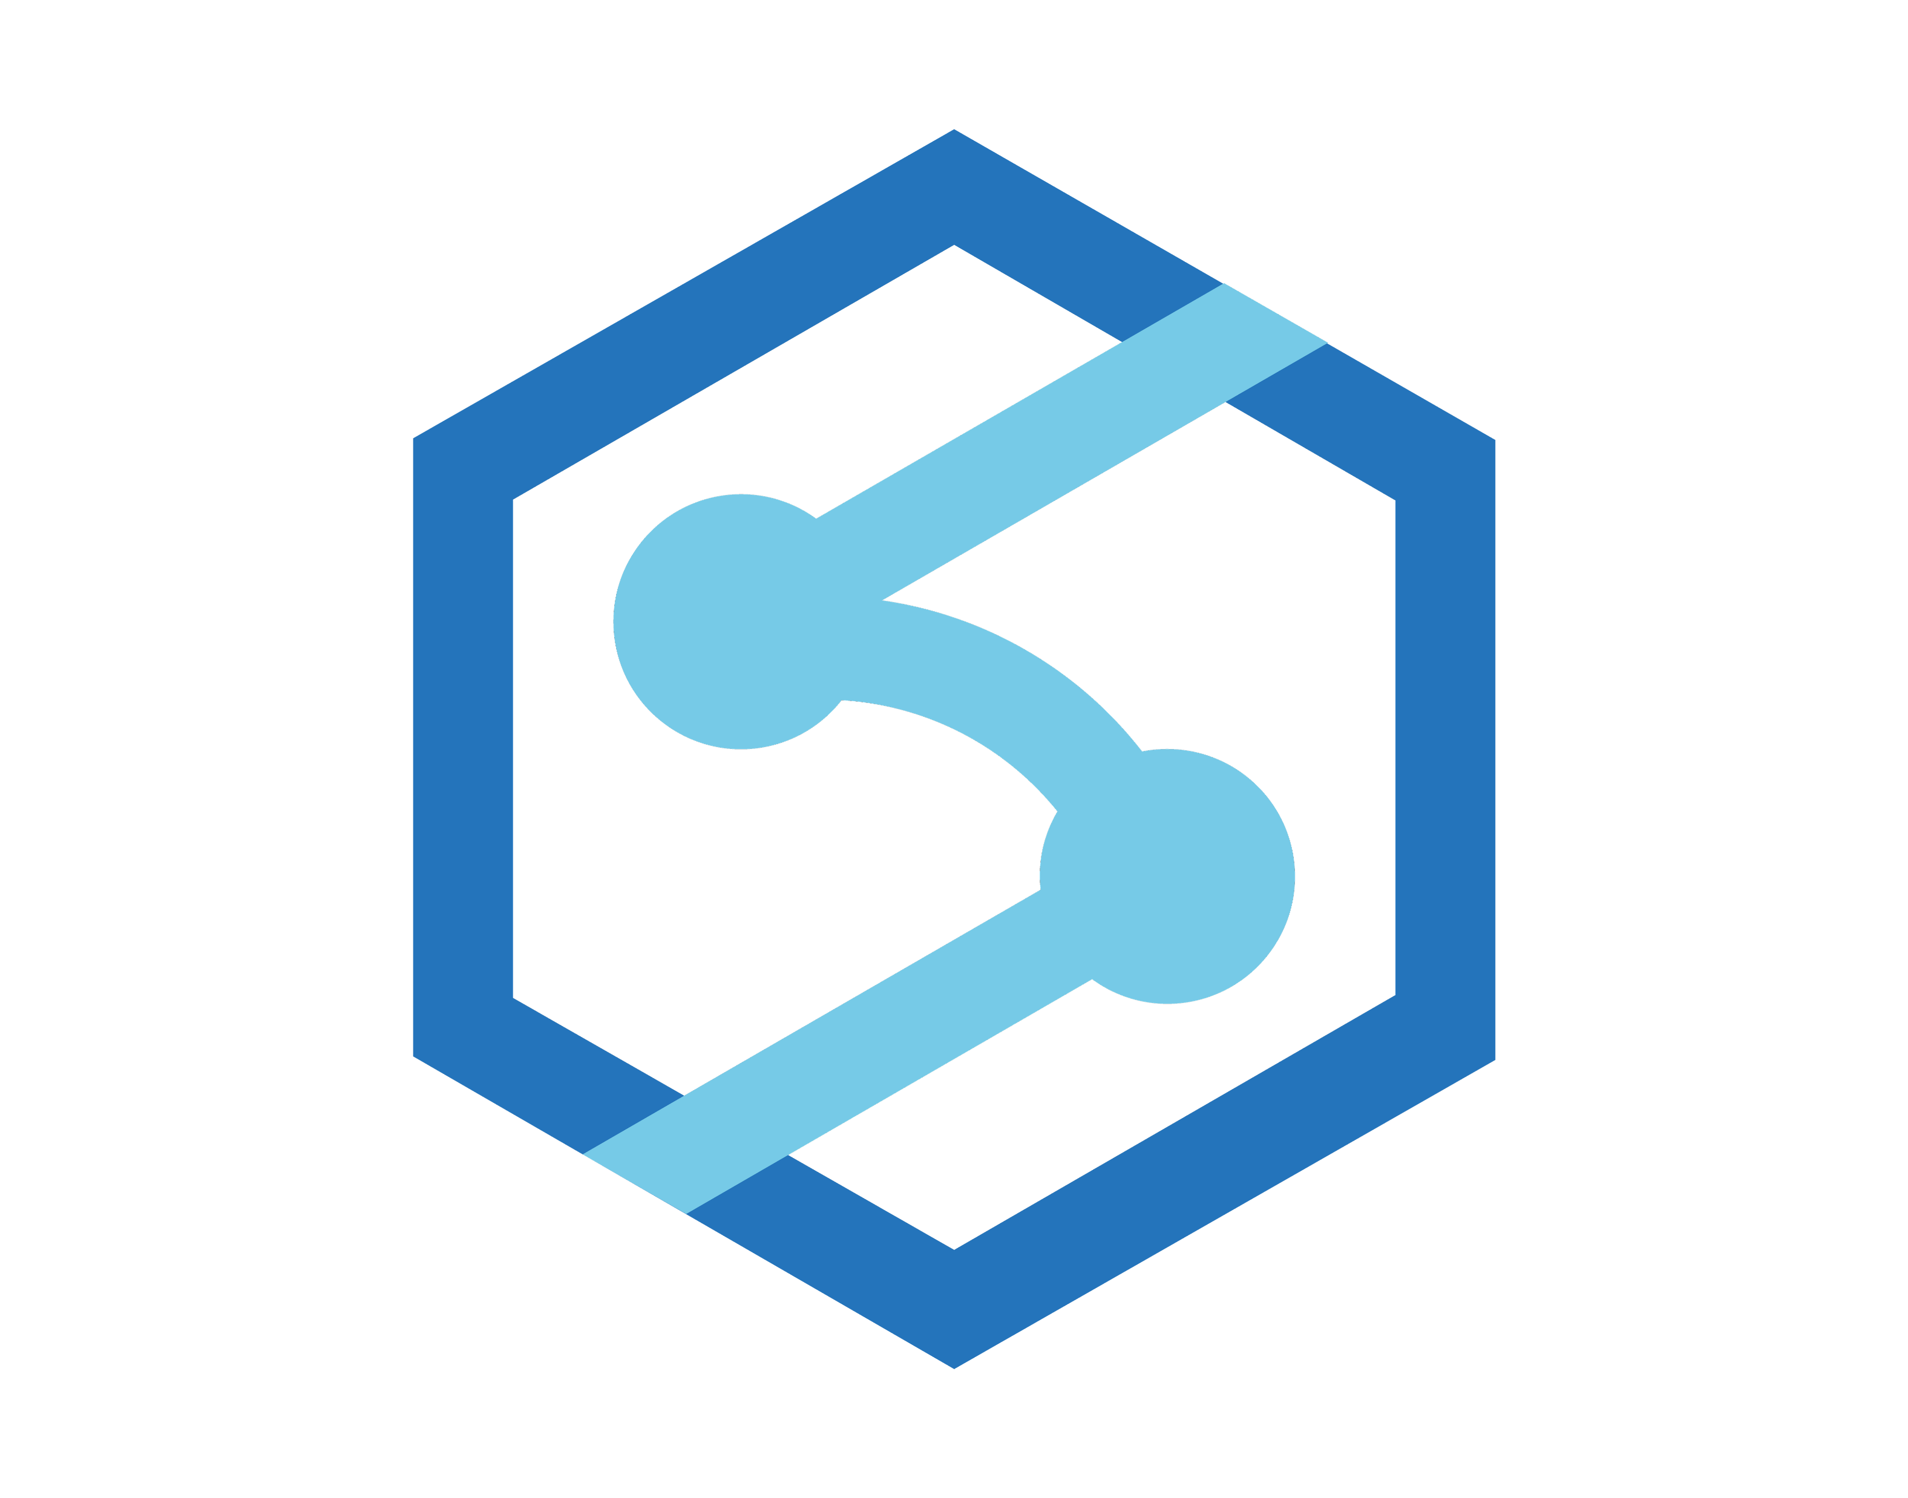














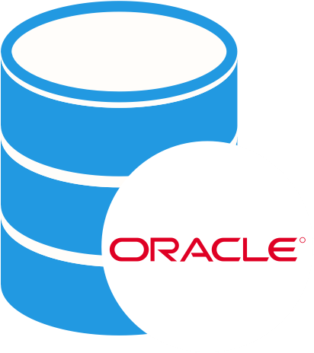












Architecture Diagram Based on the requested target stack
Main Stream
Source Data Stack
Data Stewards
Enrich
Including computer vision, NLP, and IA
Operational Stack
Ingestion
Store
Process
Notes:
The proposed architecture is designed to support structured data through a batch-based ingestion model. While the current scope does not include semi-structured or unstructured data, the architecture is extensible — enabling future integration of such formats with minimal adjustments.
Streaming and IoT data are initially out of scope, but can be incorporated through the adoption of tools like Azure Event Hubs and Azure Stream Analytics, following a Lambda architecture approach for real-time processing.
The architecture is designed exclusively for internal Allianz stakeholders. While it can be extended to support third-party and external users, doing so will require additional resources, such as Azure Data Share, to enable secure data sharing.
Azure AI Services
Custom ML models training and MLOps
End User
Serverless SQL Pools
Azure Machine Learning
Analytical Stack
Pipelines
Data Lake Storage Gen2
5
10 Business Lines
+200 Analysts
+1000 Processes
Dedicated SQL Pools
Enterprise-grade semantic model and self-service BI
Serve
Scheduled / Event Triggered data ingestion
High-performance polyglot storage
Enterprise data warehouse capabilities
SAS EG
2
3
4
Azure Synapse Analytics
Power BI Premium
Oracle DB
1
6
7
Access Management
Governance
Microsoft Purview
Share
Governance Stewards
2
Azure AD
Azure AD Grous
Maintenance
Microsoft Defender for Cloud
Azure DevOps & GitHub
Jira
Confluence
Microsoft Entra ID
Microsoft Cost Management
Azure Key Vault
Azure Monitor
Azure Policy
1
3
4
Support Stream
4/12
DISCLAIMER: Fictional content created solely for assessment use.
Notes:
Slide 4 - Architecture Diagram (5 minutes)
For the diagram, I bring in an architecture with two different streams.
Main Stream: Represents the data flow through the architecture. Data originates from the source, IBM DB2, within the Operational Stack. It is ingested using Azure Synapse Analytics Pipelines and Virtual Machines (for integration runtime triggers), then stored in Azure Data Lake Store Gen2 across the Bronze and Silver layers. Processing occurs through Azure Synapse Serverless and Dedicated Pools, where I have the Gold layer*. Data Stewards, typically associated with Data Engineers, overseeing quality throughout this flow. Enrichment is handled by Azure AI Services**, Machine Learning; Serving is handled by Power BI, delivering outputs and insights that support business processes and functional areas.
* Gold Layer in Process: Although it is cheaper to store all three layers in the Data Lake, it pays off to keep the Gold layer in the processing layer due to lower latency, finer-grained governance, and users being more familiar with consuming data in a SQL table format. In the Data Lake, performance tends to be linear, whereas in the processing layer, it is optimized. Thus, this confirms the usage of an ELT approach rather than ETL.
** Azure AI Foundry icon:
Support Stream: Covers the essential elements that enable the architecture to operate securely and efficiently. Access management is handled through Active Directory (AD) Groups, ensuring the right people have the right permissions. Governance is supported by Microsoft Purview, with Governance Stewards, typically Data Architects, overseeing compliance and standards. Maintenance relies on seven key applications to monitor, automate, and sustain the architecture. Finally, collaboration and documentation are managed through Jira and Confluence, providing structure and visibility for ongoing activities.
Notes: This architecture is primarily focused on structured data and batch ingestion. However, it is designed to be extensible, supporting semi-structured, unstructured, and streaming data if needed. While the initial focus is on serving internal stakeholders, the setup can also be extended to support third-party access when required.

Slide 5
Architecture Layers and Functionalities
Main Stream
Ingestion
Store
Process
Enrich
Serve
2
3
4
5
6
Layers
Tool/Service:
Azure Synapse Pipelines + Virtual Machines
Functionality:
Incremental extraction, transformation, and loading of data
Design Pattern:
Scheduled / Event Triggered
Tool/Service:
Azure Delta Lake Storage Gen2
Functionality:
Enables reliable, scalable data storage with ACID transactions and versioning
Layers: *
Silver and Bronze
Tool/Service:
Azure Serverless and Dedicated Pools
Functionality:
On-demand data processing and transformation at scale using parallel computing
Design Pattern:
Distributed Data Processing
Layers: *
Gold
Tool/Service:
Azure AI Services + Azure Machine Learning
Functionality:
Generative AI, NLP, intelligent automation, and predictive models
Design Pattern:
--
Tool/Service:
Power BI Premium
Functionality:
Dashboards and self-service reports
Design Pattern:
--
BRONZE
Functionality:
Scalable storage of original, unprocessed, and historical data
Design Pattern:
Delta Lake
SILVER
Functionality:
Cleaned and integrated data, ready for modeling
Design Pattern:
Delta Lake
GOLD
Functionality:
Modeled and performance-optimized data for analytics and BI
Design Pattern:
Star Schema
Access Management
Governance
Maintenance
Share
Data Stewards
Governance Stewards
1
2
3
4
Role-based access control and identity management
Metadata catalog, data lineage, classification, access policies
Security, monitoring, secrets management, automation and cost governance
Agile project management, documentation and cross-team collaboration
Manage the quality, accuracy, and consistency of data, ensuring it aligns with defined standards and is accessible for use.
Ensure data complies with policies and standards, overseeing data security, privacy, and access control to maintain compliance and ethical practices.
Support Stream
Roles
5/12
DISCLAIMER: Fictional content created solely for assessment use.
Notes:
Slide 5 - Architecture Layers and Functionalities (5 minutes)
In this slide, we can see what each item does across streams, layers, and roles. I'll focus on the items that are less intuitive to help us stay on time. Specifically, I'll explain the data layers and the key governance and maintenance aspects.
Layers: In a modern data architecture, data is organized into layers to ensure quality, reliability, and performance as it moves through the system.
Bronze refers to raw data captured directly from source systems with minimal processing.
Silver represents cleaned, filtered, and structured data, ready for basic analytics and reporting.
Gold is the refined, highly curated data that is optimized for business use, advanced analytics, and decision-making.
Governance: Governance over data architecture ensures that data is accurate, secure, and properly managed across the organization. It defines clear roles, responsibilities, and processes for how data is created, maintained, accessed, and protected. Good governance enforces data quality, compliance with regulations, security standards, and controlled access, helping build trust in the data. Ultimately, it allows the architecture to scale effectively while enabling faster, smarter, and safer decision-making.
Maintenance: Maintenance of the data architecture ensures that the environment remains healthy, secure, and cost-effective over time. It involves actively monitoring system performance, managing cloud costs through Cost Management tools, and using continuous integration/continuous deployment (CI/CD) pipelines to keep updates safe, automated, and efficient. Maintenance also includes enforcing Policies to control data usage and security standards, and managing identities and access through Entra ID (Microsoft’s modern identity platform). Together, these activities keep the architecture optimized, resilient, and aligned with business and regulatory needs.

Slide 6

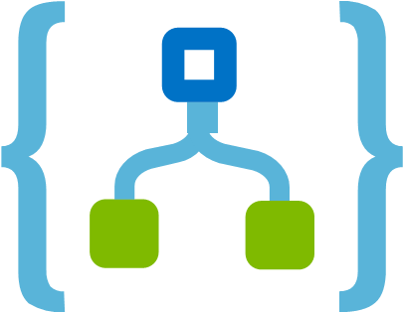


DataOps Artifacts and Modules Given the target architecture, where might there be opportunities for enhancement?
Main Stream
Opportunity
Justification
Diagram-Wise
Replace Synapse Analytics with Data Factory
Replace Virtual Machines with Azure Logic Apps
Azure Data Factory is the preferred choice for ingesting 3500 tables and 8.5 TB of data from on-premises due to its cost-efficiency, scalability, and flexibility. Unlike Synapse Pipelines, ADF uses a pay-per-use model with no need for always-on infrastructure, making it more economical for large-scale batch ingestion.
Azure Logic Apps is the preferred choice for triggering scheduled pipelines in place of virtual machines due to its serverless architecture, lower operational costs, and ease of maintenance.
Ingestion
2
Store
Fuse Gold and Silver Layers
When data transformation logic is not complex, this approach reduces redundancy and minimizes the number of pipelines and maintenance efforts. It works well in scenarios without multiple consumers or intricate business rules.
Azure Policy
3
Process
Evaluate using Spark Pools (auto-scalable) for transformation-heavy layers (Gold)
Spark Pools scale automatically and are more suitable for large-scale transformations. They can reduce long-term maintenance by separating compute and storage cleanly.
Azure Monitor
4
Enrich
Replace Azure Machine Learning with Azure ML Designer
Reduces learning curve and setup time. No need for containers, clusters, or complex scripts.
5
Microsoft Cost Management
Drivers: Reduce Maintanance and Operating Costs
6/12
DISCLAIMER: Fictional content created solely for assessment use.
Notes:
Slide 6 – Data Ops Artifacts and Modules (3 minutes)
Here, given the target architecture, I emphasize potential enhancement opportunities if we aim to reduce maintenance and operating costs.
Synapse → Azure Data Factory for better scalability and cost-efficiency. Unlike Synapse Pipelines, ADF uses a pay-per-use model with no need for always-on infrastructure, making it more economical for large-scale batch ingestion.
VMs → Azure Logic Apps for simpler, serverless orchestration, lower operational costs, and ease of maintenance.
Fuse Silver + Gold Layer when data transformation logic isn’t complex, this approach reduces redundancy and minimizes the number of pipelines and maintenance efforts. Needs to be careful with this approach.
Spark Pools for heavy transformations. Spark Pools scale automatically and are more suitable for large-scale transformations. They can reduce long-term maintenance by separating compute and storage cleanly.
To identify these opportunities, I would rely on tools like Policy, Monitor, and especially Cost Management, where I can input budget constraints and guide optimization efforts.

Slide 7
E2E Data Engineering Projects
Notes:
Slide 7 - E2E Data Engineering Projects (15 seconds)
The second topic, examples - E2E Data Engineering Projects:
Sales Dashboard
Churn Prediction Model

Slide 8
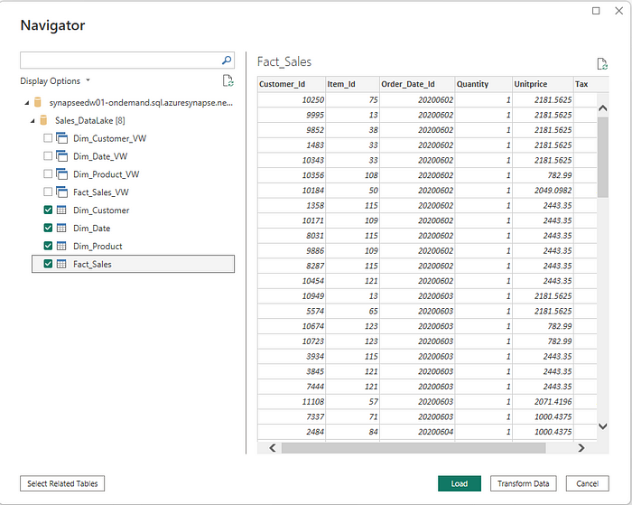
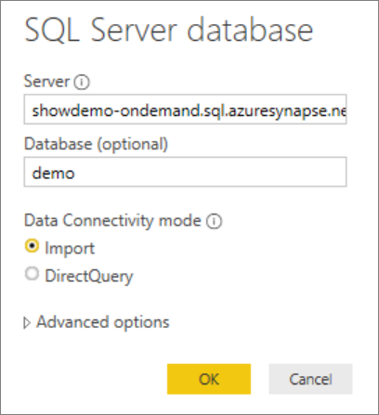

Data Model Design for Sales Dashboard
Process
Serve
client_id
client_name
client_age
client_gender
income_group
4
6
DIM Client
DIM Product
DIM Region
product_id
product_name
policy_term
term
coverage
region_id
country
state
city
FACT
sales_id
client_id
channel_id
region_id
sales_date
sales_gross_vl
discount
sales_net_vl
status
product_id
DIM Channel
DIM Time
Navigation on Synapse SQL Pools Tables and Views
channel_id
channel_type
channel_name
partner_name
date
week
month
quarter
year
Insights
Connecting to Azure Synapse Analytics SQL Pools
Performace YoY, MoM, YTD
Sales Seasonal Turns
Demographics Analysis
Policy Retention
Channel Efficiency
At-Risk Customers
Refresh schedules offset pipeline executions
8/12
DISCLAIMER: Fictional content created solely for assessment use.
Notes:
Slide 8 - Sales Dashboard — Data Model Design (2 minutes)
For the Sales Dashboard, I adopted a star schema within Power BI, featuring a central fact table connected to five key dimensions: client, product, channel, region, and time. The data flow starts in the processing layer using Dedicated SQL Pools in Azure Synapse, from where it is loaded into Power BI for modeling. In Power BI, the star schema is visually structured, allowing for efficient and intuitive analysis. For illustration, snapshots of how to establish connections with the database, access relevant tables and views, and build the data model.
This setup enables insights such as timely performance tracking, seasonal sales trends, demographic analysis, channel efficiency, and early identification of at-risk customers.

Slide 9

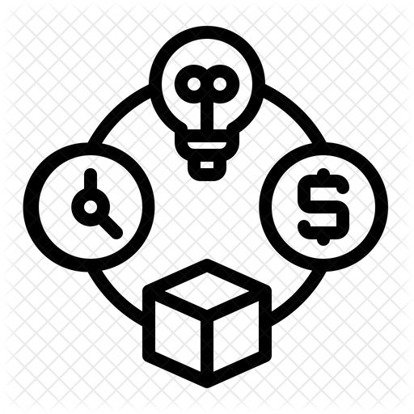


High-Level Project Plan: Sales Dashboard
Roadmap
Resources
ORGANIZATION
Phase | Week 1 |  | Week 2 |  | Week 3 |  | Week 4
Design
Build
Test
Launch
DATA TEAM
SALES TEAM
Costs
DS
DE
DA
Enablement
Operations
DSc₁
DEng₁
DAn₁
Process Owner
Stakeholders
Type | Item | Est. Cost (€/Mo)
Capex | Synapse Dedicated Pool | 1200
 | Azure VM (Triggers) | 40
 | Power BI Premium (P1) | 4700
 | GitHub Actions (CI/CD) | 40
Opex | Synapse Pipelines | 200
 | Data Lake Storage | 80
 | Azure Purview | 300
 | Azure Monitor & Logs | 50
 |  | Total: 6610
Key Activities per Phase:
Design: Requirements gathering, data model design, dashboard wireframes.
Build: Data ingestion, dimensional modeling, dashboard creation.
Test: Data validation, stakeholder review, UAT (User Acceptance Testing).
Launch: User training, go-live, production deployment, hypercare support.
DArch₁
Length: 4 – 6 weeks Max.
Team Size: 4 FTEs
Main Responsabilities per Role:
Data Engineer: Build ingestion and transformation pipelines; prepare data in Synapse.
Data Architect: Define data architecture and governance; ensure scalability and performance.
Data Analyst: Develop Power BI dashboards, KPIs, and sales analyses.
Process Owner: Define business requirements and validate dashboard deliverables.
Assumptions:
Project complexity is moderate, involving standard business logic and calculations.
The initiative is of medium priority, allowing for a balanced but timely execution.
The primary audience is the Operations Team; Leadership and Executive Teams are not direct stakeholders at this stage.
Manhour costs for internal resources are excluded from the cost estimation.
Initially, the project will rely solely on internal resources due to the sensitivity of the data (such as client information, margins, etc.). External consultants may be brought in if additional expertise is required.
8/11
DISCLAIMER: Fictional content created solely for assessment use.
Notes:
Slide 9 – High Level Project Plan: Sales Dashboard (3 minutes)
In this slide, I present how the dashboard can be built. However, before explaining the project plan, it is important to clarify a few assumptions that help narrow the scope and avoid making the approach too generic.
Assumptions:
Project complexity is moderate, involving standard business logic and calculations.
The initiative is of medium priority, allowing for a balanced but timely execution.
The primary audience is the Operations Team; Leadership and Executive Teams are not direct stakeholders at this stage.
Manhour costs for internal resources are excluded from the cost estimation.
Initially, the project will rely solely on internal resources due to the sensitivity of the data (such as client information, margins, etc.). External consultants may be brought in if additional expertise is required.
Roadmap: The project will be executed in four phases over 4–6 weeks: Design will gather business requirements, define the data model, and create dashboard wireframes; Build will handle data ingestion, star schema modeling, and dashboard development in Power BI; Test will focus on data validation, stakeholder review, and User Acceptance Testing (UAT); and Launch will deliver user training, production deployment, and hypercare support to ensure smooth adoption.
Resources: The team will consist of four FTEs: a Data Engineer responsible for ETL development, a Data Architect to design scalable and high-performing data structures, a Data Analyst to translate business needs into dashboard outputs, and a Process Owner to ensure alignment with operational requirements. In agreement with Assumption #5, at first external resources will not be demanded.
Costs: Monthly operational costs (OPEX) will include software licensing and Azure services, depending on the final deployment architecture. If any initial infrastructure investment (CAPEX) is needed, it will be estimated and allocated separately. This is an estimation, and the values provided were created using Microsoft’s cost simulator, which may contain significant discrepancies when applied to corporate environments. For this high-level plan, I’m also factoring in a high-performance team—characterized by strong collaboration, autonomy, and a clear focus on results—which supports the ambitious timeline and the number of resources allocated.

Slide 10

Data Model Design for Churn Prediction
Process
Enrich
Feature Selection
4
5
Problem Understanding
client_id
client_name
client_age
client_gender
income_group
risk_profile
Deployment
Data Mining
DIM Client
Evaluation
LIFE CYCLE
Data Preparation
DIM Product
DIM Region
Features
product_id
product_name
policy_term
term
coverage
region_id
country
state
city
Modeling
Data Cleaning
FACT
sales_id
client_id
channel_id
region_id
sales_date
sales_gross_vl
discount
sales_net_vl
status
product_id
churn_label
Feature Engineering
DIM Channel
DIM Time
Process
Serve
channel_id
channel_type
channel_name
partner_name
date
week
month
quarter
year
4
6
Output
Churn Predicted (ranged 0 to 1)
10/12
DISCLAIMER: Fictional content created solely for assessment use.
Notes:
Slide 10 - Churn Prediction — Data Model Design (2 minutes)
For the Churn Prediction Model, I’m applying a similar approach; however, this use case involves completing the full data science development lifecycle. In parallel, I’m leveraging a star schema to support feature selection during the data-centric steps. The data flow begins in the processing layer using Serverless SQL Pools in Synapse, where the data is accessed for training and testing machine learning models. Once the model is built and evaluated, the resulting scores are written back to the processing layer, this time into Dedicated SQL Pools. From there, the data is loaded into Power BI for modeling and visualization. The final output of this process is a churn probability score for each client, ranging from 0 to 1.

Slide 11
High-Level Project Plan: Churn Prediction
Roadmap
Resources
ORGANIZATION
Phase | Week 1 | Week 2 | Week 3 | Week 4 | Week 5 | Week 6
Problem Understanding
Data Mining
Data Preparation
Feature Engineering
Modeling
Evaluation
Deployment
DATA TEAM
SALES TEAM
Costs
DA
DE
DS
Enablement
Operations
Type | Item | Est. Cost (€/Mo)
Capex | Synapse Serverless + Dedicated Pools | 1800
 | Azure VM (Triggers) | 30
 | Power BI Premium (P1) | 4700
 | GitHub Actions (CI/CD) | 40
Opex | Synapse Pipelines | 200
 | Data Lake Storage | 80
 | Azure Purview | 300
 | Azure Monitor & Logs | 50
 | Azure Machine Learning | 100
 |  | Total: 7300
DAn₁
DEng₁
DSc₁
Process Owner
Stakeholders
DArch₁
Key Activities per Phase:
Problem Understanding: Define the churn problem and business objectives.
Data Mining: Gather relevant data (e.g., client interactions, transactions).
Data Preparation: Clean, transform, and organize data.
Feature Engineering: Create relevant features from raw data.
Modeling: Select and train ML models to predict churn.
Evaluation: Assess model performance using metrics (e.g., accuracy, AUC-ROC).
Deployment: Implement the model in production and monitor its performance.
Team Size: 5 FTEs
Length: 6 – 8 weeks Max.
Main Responsabilities per Role:
Data Engineer: Build ingestion and transformation pipelines; prepare data in Synapse.
Data Architect: Define data architecture and governance; ensure scalability and performance.
Data Scientist: Develop models, perform feature engineering, and analyze output.
Data Analyst: Develop Power BI dashboards, with key visualizations.
Process Owner: Define business requirements and validate model output.
Assumptions:
Project complexity is moderate, involving standard business logic and calculations.
The initiative is of medium priority, allowing for a balanced but timely execution.
The primary audience is the Operations Team; Leadership and Executive Teams are not direct stakeholders at this stage.
Manhour costs for internal resources are excluded from the cost estimation.
Initially, the project will rely solely on internal resources due to the sensitivity of the data (such as client information, margins, etc.). External consultants may be brought in if additional expertise is required.
11/12
DISCLAIMER: Fictional content created solely for assessment use.
Notes:
Slide 11 – High Level Project Plan: Churn Prediction (2 minutes)
Once again, following the same logic as for the Sales Dashboard.
Assumptions: The assumptions for this project will remain the same as for the Sales Dashboard.
Roadmap: The churn prediction model will be developed over a 6–8 week period. By nature, data science initiatives are slightly longer due to the additional steps involved. The first phase, Problem Understanding, will define the scope of churn prediction and establish the business objectives. In the Data Mining phase, the focus will be on identifying and gathering relevant data sources. The Preparation phase will involve cleaning and structuring the data for analysis. During Feature Engineering, meaningful variables will be created to capture patterns in customer behavior. The Modeling phase will apply machine learning algorithms to predict churn probability. In the Evaluation phase, the model’s performance will be assessed using metrics such as precision and recall. Finally, during Deployment, the model will be integrated into production to enable churn predictions.
Resources: The team for this project will consist of five FTEs, each with a specific role. A Data Engineer will be responsible for data ingestion and preparation. A Data Architect will design the data architecture and ensure its scalability. A Data Analyst will perform exploratory data analysis and prepare the datasets for modeling. A Data Scientist will develop and train the churn prediction model, including feature selection and tuning the machine learning algorithms. Lastly, a Process Owner will oversee the project execution, ensuring it aligns with the operational objectives.
Costs: The cost structure will remain the same, with adjustments made for the specific functionalities and tools required.
High-performance principles applicable as well.

Slide 12
Thank you!
GitHub Public Repository: https://github.com/Nesk95/Allianz_BusinessCase.git
Any questions?
Notes:
Slide 12 - Thank You / Questions (30 seconds) That concludes my prototype demonstration. Thank you for your time.
You can access the one-pager, this presentation, and my speaking notes on my GitHub. I’ll share the link in the chat.
Now, I’ll stop sharing and open the floor for any questions.

